Slide 1
FEATURE EXTRACTION

Slide 2
Principal component analysis (PCA)
Principal component analysis (PCA) is a statistical procedure that is used to reduce the dimensionality. It uses an orthogonal transformation to convert a set of observations of possibly correlated variables into a set of values of linearly uncorrelated variables called principal components. It is often used as a dimensionality reduction technique.

Slide 3
Steps Involved in the PCA
Step 1: Standardize the dataset.
Step 2: Calculate the covariance matrix for the features in the dataset.
Step 3: Calculate the eigenvalues and eigenvectors for the covariance matrix.
Step 4: Sort eigenvalues and their corresponding eigenvectors.
Step 5: Pick k eigenvalues and form a matrix of eigenvectors.
Step 6: Transform the original matrix.

Slide 4
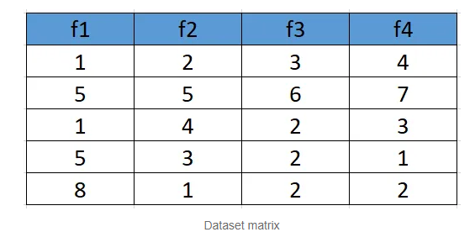
1. Standardize the Dataset
Assume we have the below dataset which has 4 features and a total of 5 training examples.
First, we need to standardize the dataset and for that, we need to calculate the mean and standard deviation for each feature.

Slide 5
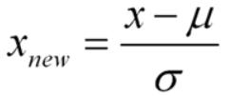
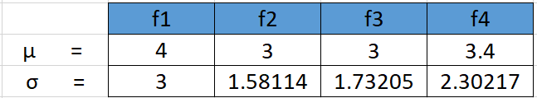

Slide 6
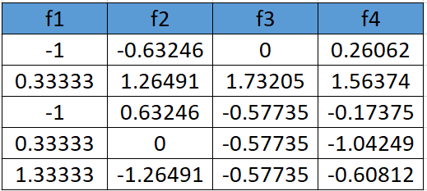
After applying the formula for each feature in the dataset is transformed as below:

Slide 7
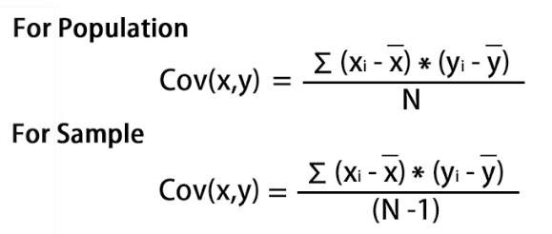
2. Calculate the covariance matrix for the whole dataset
The formula to calculate the covariance matrix:

Slide 8
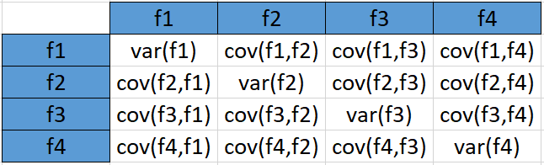
the covariance matrix for the given dataset will be calculated as below

Slide 9
Since we have standardized the dataset, so the mean for each feature is 0 and the standard deviation is 1.
var(f1) = ((-1.0-0)² + (0.33-0)² + (-1.0-0)² +(0.33–0)² +(1.33–0)²)/5 var (f1) = 0.8
cov(f1,f2) = ((-1.0–0)*(-0.632456-0) + (0.33–0)*(1.264911-0) + (-1.0–0)* (0.632456-0)+ (0.33–0)*(0.000000 -0)+ (1.33–0)*(-1.264911–0))/5 cov(f1,f2 = -0.25298
In the similar way be can calculate the other covariances and which will result in the below covariance matrix

Slide 10
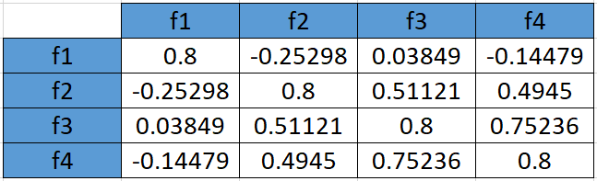

Slide 11
3. Calculate eigenvalues and eigen vectors.
An eigenvector is a nonzero vector that changes at most by a scalar factor when that linear transformation is applied to it. The corresponding eigenvalue is the factor by which the eigenvector is scaled.
Let A be a square matrix (in our case the covariance matrix), ν a vector and λ a scalar that satisfies Aν = λν, then λ is called eigenvalue associated with eigenvector ν of A. Rearranging the above equation,
Aν-λν =0 ; (A-λI)ν = 0
Since we have already know ν is a non- zero vector, only way this equation can be equal to zero, if
det(A-λI) = 0

Slide 12

A-λI = 0

Slide 13
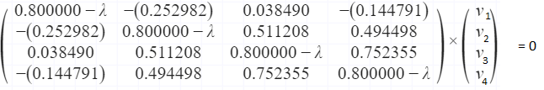
Solving the above equation = 0
λ = 2.51579324 , 1.0652885 , 0.39388704 , 0.02503121
Eigenvectors:
Solving the (A-λI)ν = 0 equation for ν vector with different λ values:

Slide 14
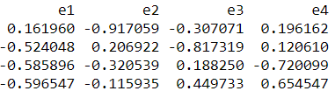
For λ = 2.51579324, solving the above equation using Cramer's rule, the values for v vector are
v1 = 0.16195986 v2 = -0.52404813 v3 = -0.58589647 v4 = -0.59654663
Going by the same approach, we can calculate the eigen vectors for the other eigen values. We can from a matrix using the eigen vectors.
eigenvectors(4 * 4 matrix)

Slide 15
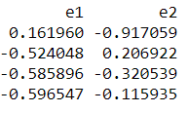
4. Sort eigenvalues and their corresponding eigenvectors.
Since eigenvalues are already sorted in this case so no need to sort them again.
5. Pick k eigenvalues and form a matrix of eigenvectors
If we choose the top 2 eigenvectors, the matrix will look like this:
Top 2 eigenvectors(4*2 matrix)

Slide 16
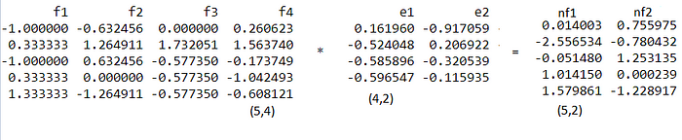
6. Transform the original matrix.
Feature matrix * top k eigenvectors = Transformed Data
Data Transformation

Slide 17
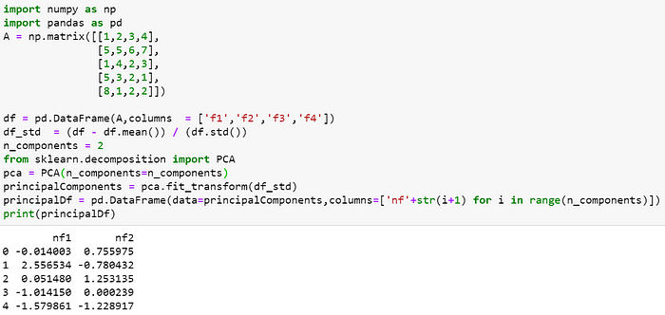
Compare with sklearn library

Slide 18
Linear Discriminant Analysis
Linear discriminant analysis is a classification algorithm which uses Bayes’ theorem to calculate the probability of a particular observation to fall into a labeled class. It has an advantage over logistic regression as it can be used in multi-class classification problems and is relatively stable when the classes are highly separable. LDA was meant to solve the multi-class classification problems but here we will consider a two-class classification problem with a single predictor variable for simplicity. Consider a very simple example of predicting the gender of a person through his/her height by the data as shown below:

Slide 19
Steps in LDA model training:
Calculate the mean of variable for each class.
Calculate the variance of the variable for each class.
Calculate the probability of each class (prior probability).
Use the values of mean, variance and prior probability to develop final model by assuming normal distribution of the variable in each class.

Slide 20
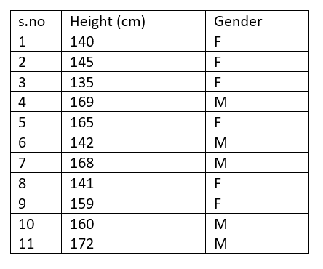
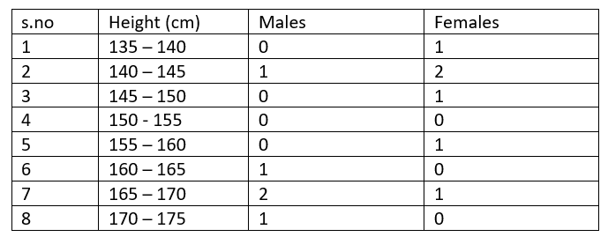
EXAMPLE
The above data set will be used to develop a model through LDA and before doing that we will check it for the assumptions of LDA to see if this particular algorithm can be implemented. We have to first make a frequency table out of it with height column represented in class intervals like as shown below:

Slide 21
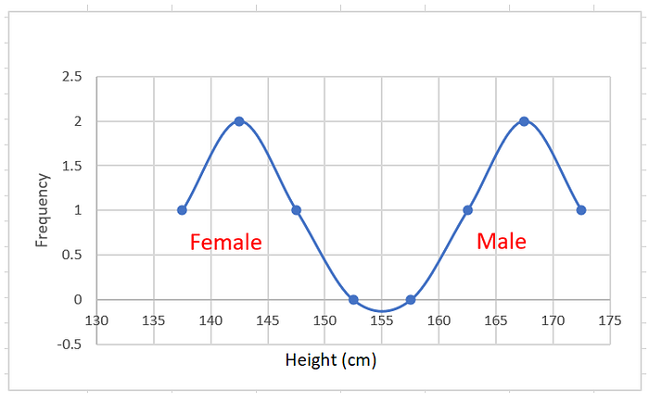
You see, the frequency of every class interval is written against it for both the classes and we will plot the above table to check how well the first assumption is met by it:
The above graph shows the normal distribution of height variable for both the classes, hence the first assumption is satisfied.

Slide 22
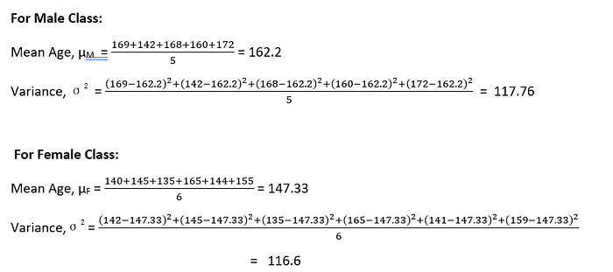
Now let’s calculate the mean and variance for the two classes.
The Variance of the variable under consideration is almost equal in both the classes and here with it is met the second assumption of LDA.

Slide 23

Let’s now directly jump to the linear discriminant analysis where our main focus will be to train a model from the above data, so that we can predict the gender of some other person given his/her height and whose information is not present in the above table. In other words you should be able to answer the question of what will be gender of a person whose height is say 152 cm.
LDA relies heavily on Bayes’ Theorem which, as I said is a pre requisite to understand this article. The Bayes’ Theorem states that:

Slide 24
I will try to explain it a bit. P(A1|B) is read as the Probability of A1 given B. It means the probability of event A1, when event B has already occurred e.g. Probability of Rainfall when humidity is above 80% can be written as P(Rainfall | Humidity > 80%). P(B|A1) will be the above situation flipped i.e. probability of high humidity when rainfall has already occurred. P(A1) is called the prior probability, in this case the probability of rainfall. An important point to note down is that if A1 represents occurrence of rainfall, A2 will be the event of no rainfall, a two-class problem and all the other terms will get the usual meaning.
With that said about Bayes’ theorem and assuming that you have a prior knowledge about the same, let’s focus again on LDA. For the data table given to us we need to check the probability of a height value falling in two classes of gender. Which means we will have to calculate:

Slide 25
P (gender = male | height = 152) and P (gender = female | height = 152) and then check which probability value is higher. We will first calculate the probability of male class, which as per Bayes’ theorem is equal to:

Slide 26
Let’s calculate the terms in the right-hand side of the equation one by one:
P(gender = male) can be easily calculated as the number of elements in the male class in the training data set divided by total number of elements i.e. 5/11 = 0.454. Also P(gender = female) will be 6/11 = 0.545.
Now we have to calculate the conditional probability terms, which will be found out through the first assumption of LDA, yes, the distribution of a variable in each class is normal.
In simple words, P(height = 152 | gender = male) will follow normal/gaussian distribution and P(height = 152 | gender = female) will follow normal/gaussian distribution too.

Slide 27
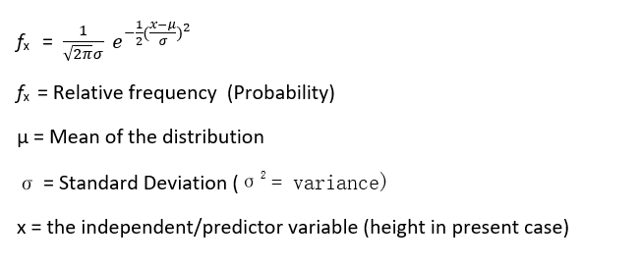
We know the equation of a normal curve is:

Slide 28
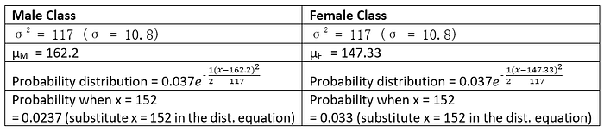
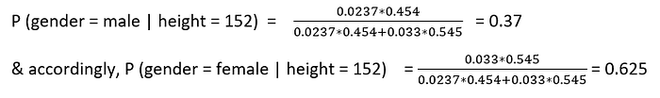
Let’s put the above values in the Gaussian equation for both the classes:
Plugging the above derived values in the (eq. 2) we have:
Now as it is evident that the P(gender = male| height = 152) is less than that of P(gender = female |height = 152), we can classify the height of 152 cm in the female class.

Slide 29
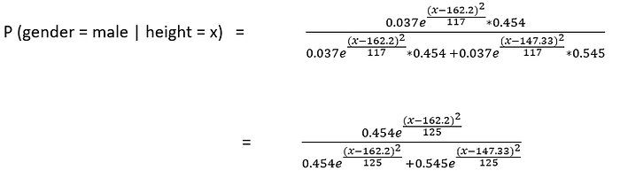
This is how linear discriminant analysis works. To show you a little general view, we will plug the distribution equations in the base equation (eq. 2) to see the model that is actually trained in this algorithm:
The same type of equation can be used to find P(gender = female | height = x) for any value of height.

Slide 30
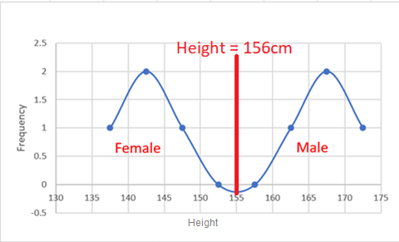
Linear for a reason
Let’s do a few more calculations to prove an another point. What will be the probabilities for height = 156cm. Substitute the value in above equations and you will find that the probabilities for both female and male class is almost equal (0.5). It is that value of height which acts as a threshold. All the height values above 156cm will be classified as male and those below will be classified as female. A graphical representation is shown below:
As is evident from the above graph, the linear discriminant analysis always draw a straight or linear separation boundary.

Slide 31
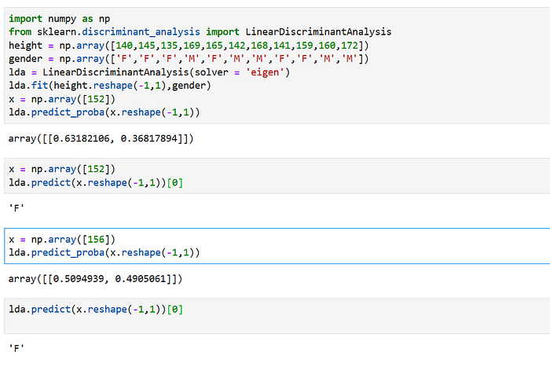
LDA CALCULATION USING PYTHON

